Slide 1

LoLValu8
A Data Science Capstone Project
By Akshay Bhasin
Notes:
Hello everyone, welcome back to my presentation on my capstone project, which I have now dubbed LoLValu8.

Slide 2
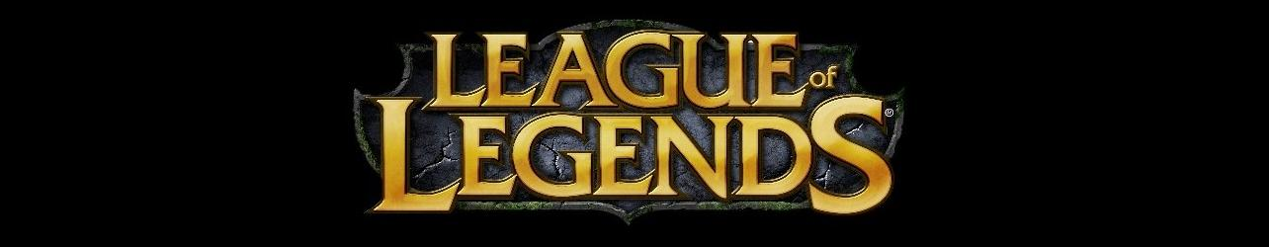

Topic
Explore the key factors to success in ranked matches with people who play the character Nasus in League of Legends
The key factors come from post match summary data for only this one player
Develop a method to evaluate a Nasus player’s performance using a Machine Learning Model
Notes:
So the first thing I want to do is remind everyone about my topic.
The topic I had picked for my project was gaming with the game being League of Legends.
I had chosen to explore what factors make players good with the character Nasus, and help them win games.
Ultimately, I wanted to develop a tool for players to assess their performance post game so that could improve their skills .

Slide 3

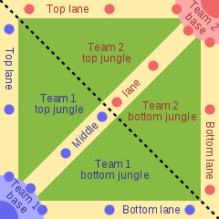
What is League of Legends (LoL)?
Multiplayer online battle arena (MOBA) video game
2 Teams of 5 compete to destroy the opponents' base
One of the largest E-sports
LoL World Championship in NA 2019
$2.2 Million USD total prize pool
100 million viewers worldwide
NBA had 15.14 Million viewers in 2019
Notes:
So now some of you might be asking, What the heck is league of legends?
League of legends is a Multiplayer Online Battle Arena Video game, where 2 teams of 5 compete to destroy the opposing teams base.
It is currently one the biggest E-sports in the world. Just last year in the LoL World Championship in NA, the prize pool was 2.2 Million USD and it was watched by over 100 Million people.
To put this into perspective, the NBA had only a mere 15 Million viewers in 2019. So it’s a big deal.

Slide 4
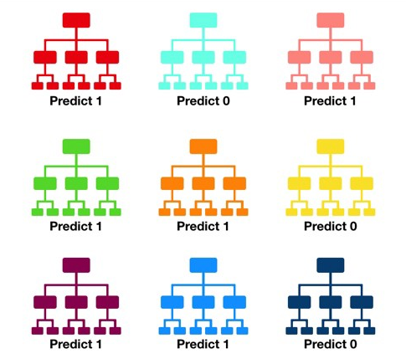
Data Processing and Modelling
Get Requests to Dev API for Users Relevant User Match Data Cleaning and Feature Engineering
Final DataFrame Results: (11818, 279)
Preliminary Models:
Note: Train/Test Split was 80/20
Logistic Regression, Test Accuracy = 0.895
KNN Classifier, Test Accuracy = 0.683
Decision Trees, Test Accuracy = 0.800
Selected Model
Random Forest Classifier
N_estimators
Max_depth
Min_samples_leaf
CV = 5
Notes:
So how did start?
I began by collecting, cleaning and feature engineering end of game summary data for players who played Nasus.
I collected this data using the game developer's API.
I had to deal with converting this data which was in json fromat into readable dataframes.
The final data frame resulted in(11818, 279)
I then ran some preliminary models using a train test split of 80/20.
These model tried to predict if the player won!
Some of the models I tested were:
Logistic Regression
KNN
Decision Tree
The results on the test sets can be seen the slide with my best one being logistic regression.
However I settled on using decision trees over either model because I didn’t want to have to scale or transform my data.
To get a better accuracy I decided to use an ensemble of decision trees otherwise known as the Random Forest Classifier, because what better than 1 decision tree and 1 data set?
Many decision trees and many subsets of data!
I selected 3 hyperparameters to tune in the model via a pipeline and gridsearch using a cross validation of 5.
The hyperparameters I tuned were n_estimators, max_depth and min_samples_leaf.

Slide 5
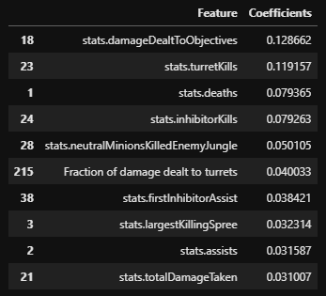
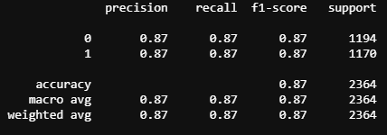
Model Results
Accuracy Test: 0.871
Accuracy Train: 0.912
Features with Highest Importance:
Damage Dealt to Objectives
Turret Kills
Deaths
Precision, Recall and F1-Score:
Precision: 0.87
Recall: 0.87
F1-Score: 0.87
Notes:
After tuning I got the following results on this slide.
I also pulled out what features that the model is classifying as important to determining the outcome, which can also be see on this slide.
On thing to note with the model, it only tells me what is important and not how the values impact the overall decision.

Slide 6

How does the App work?
The app calculates a player's performance by feeding match data into the trained model
The model then calculates a prediction score for the positive outcome
This prediction score is outputted as the player’s performance
Steps:
User inputs LoL username in NA region
The app gets Data from League API and generates the users match list
User selects match from match list
Performance score is calculated
Notes:
Okay that great, but how does this help me? How do I use this to get player performance score?
Well, what I can do is take this trained model is feed in match summary data and the model can calculate a probability score which I can then use as the performance score. So let’s see this in action.

Slide 7
Demo

Slide 8
Future Plans
XGBoost Model
Automated continuous model updating
More visualizations and feature engineering
More champion analysis and models
Team analysis and performance predictions
Notes:
Create an optimized Xgboost model for better accuracy
Create a framework to continuously update my model with fresh data
Adding more visulizations and features to the app
Adding more models for the other champions
Creating a model to evaluate team performance using the individual player performance.

Slide 9
Questions?

